Slide 1
Agile way of Application Development

Slide 2
Process for Application Development
List out the features
Create stories for each features / activity
Create task(s) for each story
Jira / azure devops board to track change
Create Git private repository to handle version control and encapsulation
Use Community version for Visual studio for development
Use SQL server express edition for development
Create .Net core MVC REST API contracts
Ability to consume from various device application
Create .Net core MVC project for development
Consume REST API for each & every activity
View should depend on ViewModels only
Use Angular JS for client side business rule with .cshtml
Suggesting to use Bootstrap 4.0 for styling by Default
Write sql procedure for all database activity
Avoid raw query
Avoid wring query in .Net code
Continuous Integration & Deployment

Slide 3
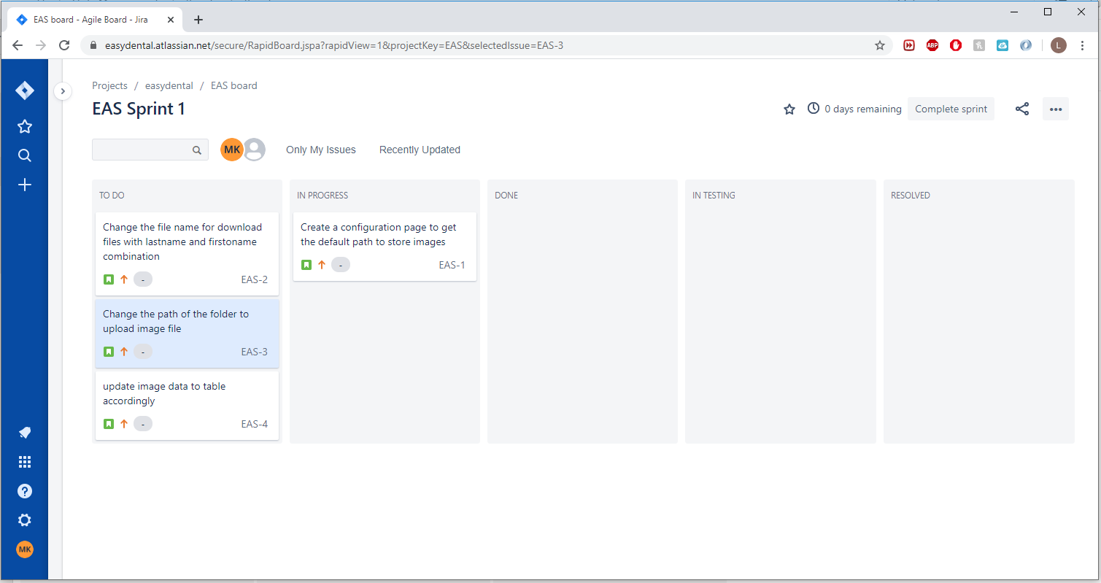
JIRA Kanban Board

Slide 4
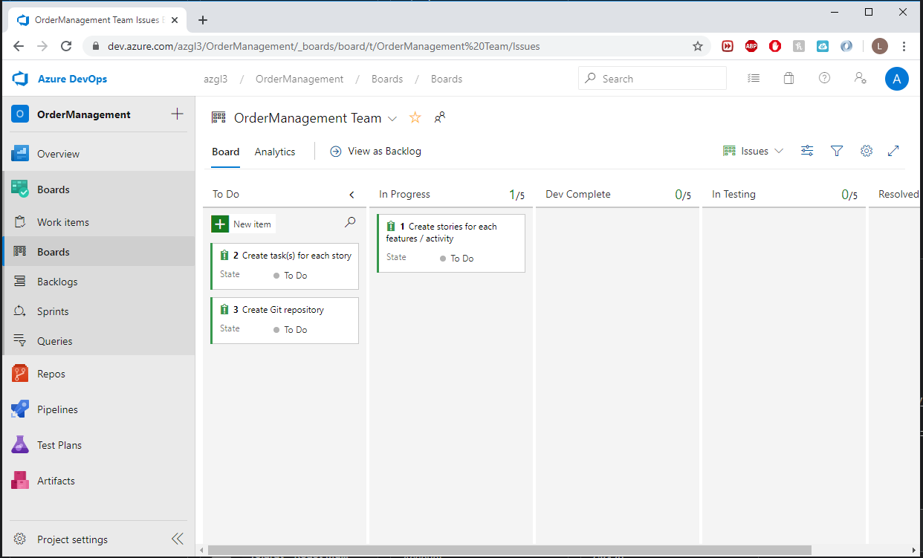
Azure Board

Slide 5
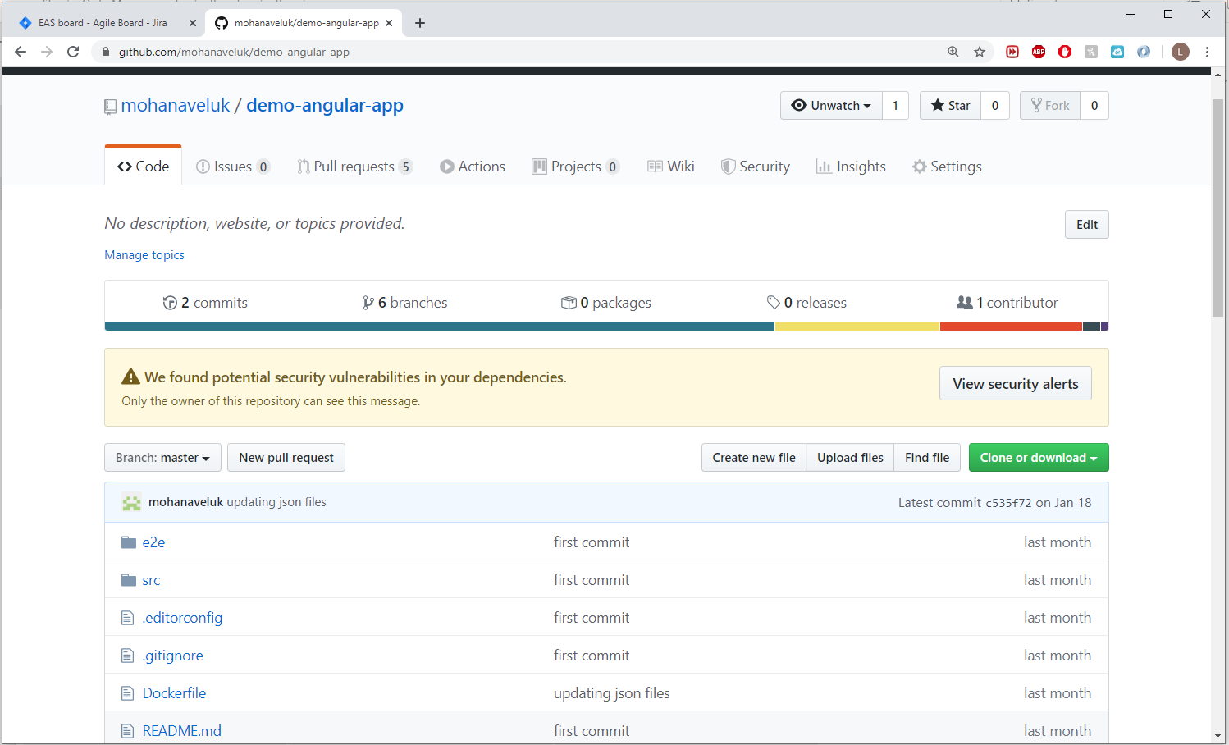
Github Repository

